Slide 1
Identity profile of people experiencing a sense of risk on the internet: Using various classification techniques
Presented by,
Harish S 125015047(IT)

Slide 2
AGENDA
Base Paper Details
Abstract
Introduction
(i) Domain
(ii) Problem Statement
Literature Survey
Data Set
Work Plan
Conclusion
References

Slide 3
BASE PAPER DETAILS:
Base paper URL : https://www.sciencedirect.com/science/article/pii/S0360131523000209#sec3
Title of the Base Paper : Identity profile of young people experiencing a sense of risk on the internet
Year of publication : 2023
ISSN NO : 0360-1315
Cite score : 23.8
Impact factor : 12
Indexed in : SCOPUS

Slide 4
ABSTRACT
This presentation investigates young people's perception of internet-related risks using quantitative research. With 984 respondents, the Chi-square Automatic Interaction Detector (CHAID) algorithm is applied to classify variables influencing their sense of risk. Major factors include isolation without internet usage, sleep, suicide rate, headache and fear. Surprisingly, those feeling isolated offline report lower online risk perception. Education must provide strategies for healthy internet use. This project highlights the necessity of understanding and addressing young people's internet usage behaviors to promote responsible online engagement and mitigate potential risks.

Slide 5
INTRODUCTION
Domain-Data Mining
Data mining is the process of discovering hidden patterns, correlations, and trends within vast datasets. It involves employing various algorithms and techniques to extract actionable knowledge, enabling informed decision-making and predictive modeling across diverse domains.
The methodologies of data mining encompass a wide array of techniques, including classification, clustering, association rule mining, regression analysis, and anomaly detection. Each methodology serves distinct purposes, allowing practitioners to extract meaningful patterns and derive insights tailored to specific objectives.

Slide 6
PROBLEM STATEMENT
As internet usage among young people surges, concerns arise regarding their perception of online risks. This quantitative research aims to ascertain whether young individuals acknowledge such risks and delineate the demographics and behaviors associated with this perception. By employing the CHAID classification tree technique, the study identifies pivotal factors influencing youths' sense of online risk, highlighting the paradoxical relationship between internet-induced isolation and risk perception. The findings underscore the urgency for educational interventions to foster a balanced and informed approach to internet usage among youth, promoting digital literacy and responsible online behavior.

Slide 7
LITERATURE SURVEY
S No | Paper title | Year | Technique | Advantages | Disadvantages
1 | Next-generation cyber attack prediction for IoT systems: Leveraging multi-class SVM and optimised CHAID decision tree | 2023 | CHIAD (Chi-squared Automatic Interaction Detection) is a decision tree induction method that uses the chi-squared test to determine the most significant variables to split the data at each node. | Handles Categorical Variables: CHAID is specifically designed to handle categorical predictor variables, making it suitable for datasets with a mix of categorical and continuous variables. | Lack of Pruning: Unlike some variants of normal decision tree algorithms (e.g., CART), CHAID does not typically perform pruning to reduce overfitting, which can result in overly complex trees that generalize poorly to new data.
2 | Predicting financial performance for listed companies in Thailand during the transition period: A class-based approach using logistic regression and random forest algorithm | 2023 | Logistic regression models the probability of binary outcomes based on predictor variables using the logistic function, providing interpretable coefficients for prediction. | Probabilistic Output:Logistic regression outputs probabilities of class membership, which can be useful for ranking and prioritizing predictions. | Sensitivity to Outliers Logistic regression is sensitive to outliers in the data, which can affect the estimation of coefficients and degrade model performance.

Slide 8
WORK PLAN
GOAL | OBJECTIVE | TIMELINE
I | Collecting datasets and preprocessing the collected dataset for the further work. | Month 1
II | Applying separate logistic regressions were performed using the inverse selection of conditional variables method to identify the factors of young people’s sense of online risk. | Month 2
III | The significant predictors in the previous stage were then used in the decision tree with CHAID algorithm | Month 3

Slide 9
SYSTEM ARCHITECT DIAGRAM
9

Slide 10
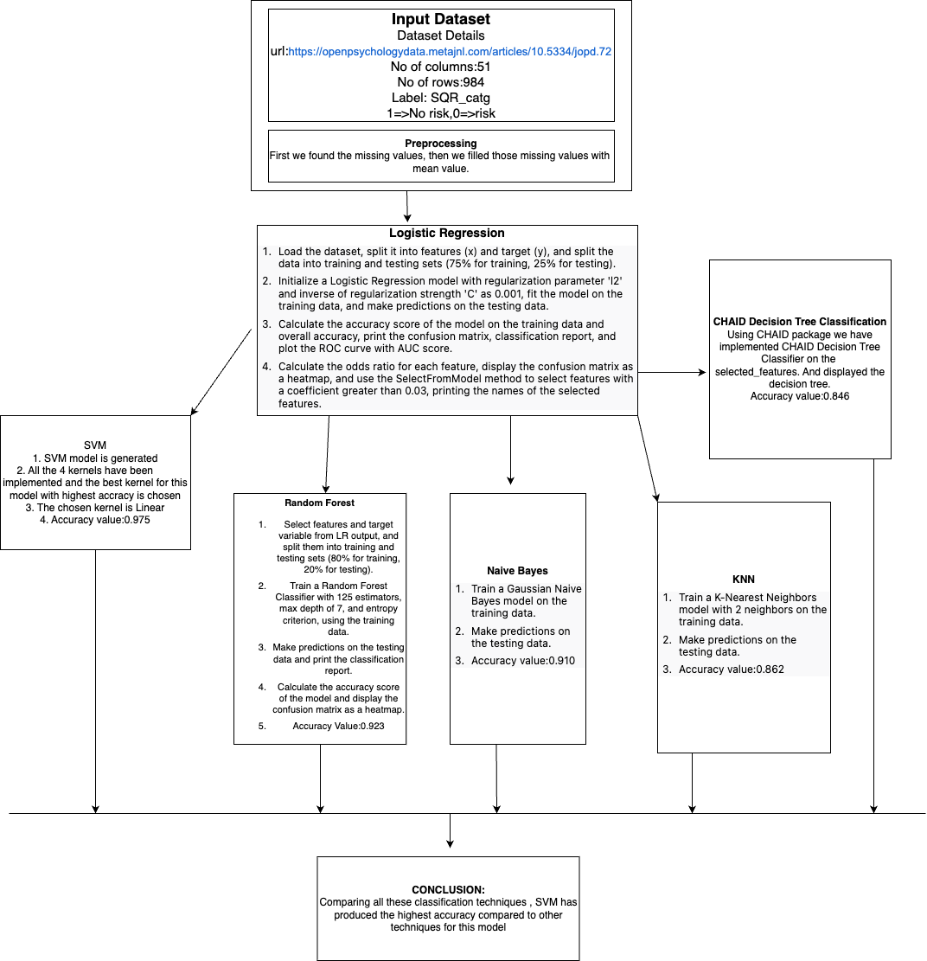

Slide 11
ALGORITHMS:
Logistic Regression
CHAID Algorithm with Decision Tree

Slide 12
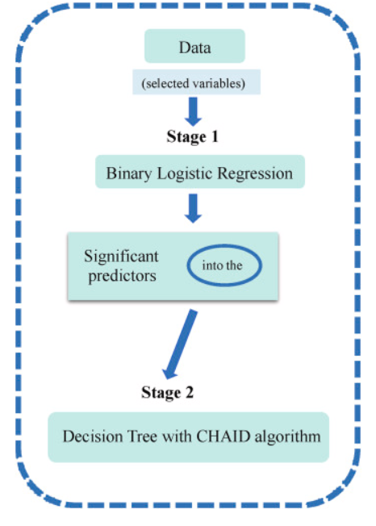
PROCEDURE:

Slide 13
DATASET URL:
https://openpsychologydata.metajnl.com/articles/10.5334/jopd.72

Slide 14
About Dataset:
This dataset studies the patterns and effects caused by internet usage
The dataset contains 51 Columns which are discrete and continuous values
There are a total of 984 Entries in this dataset
The dataset contains the effects of internet usage among various categories of the College students]
The dependent value is SQR_catg ( 0 => Risk , 1 => No Risk )

Slide 15
Dataset Description:
1. ID: Respondent identity
- Type: String (str3)
- Unique values: 984
- Missing: 0
-std.dev:17.7607
-mean:39.4482
2. Internet_usg: Total internet usage scores
- Type: Numeric (double)
- Range: 0 to 90
3. Internet_Add: IAT score ranges
- Type: Numeric (double)
- Range: 0 to 3
- Categories:
- 0: Less than 20
- 1: 20 to 39
- 2: 40 to 69
- 3: 70 to 100
4. Gender: Gender in categories
- Type: Numeric (double)
- Categories:
- 0: Female
- 1: Male
- 2: Prefer not to say
5. Age_grp: Age group
- Type: Numeric (double)
- Categories: 0 to 5, 9 (Missing)
6. Level_study: Level of Study
- Type: Numeric (double)
- Categories:
- 0: Undergraduate
- 1: Postgraduate
- 7: Missing
7. Yr_study: Year of study
- Type: Numeric (double)
- Categories: 0 to 3, 7 (Missing)
8. Discipline: Discipline of Study
- Type: Numeric (double)
- Categories:
- 0: Science
- 1: Humanities and Social Science
- 7: Missing

Slide 16
Dataset Description:
9. stay_online: How often do you stay on-line longer than intended?
- Type: Numeric (double)
- Categories: 0 to 5, 99 (Missing)
10. neglect_chores: How often do you neglect household chores to spend more time on-line?
- Type: Numeric (double)
- Categories: 0 to 5, 99 (Missing)
11. excitement: How often do you prefer the excitement of the Internet to intimacy with your partner?
- Type: Numeric (double)
- Categories: 0 to 5, 99 (Missing)
12. relationships: How often do you form new relationships with fellow on-line users?
- Type: Numeric (double)
- Categories: 0 to 5, 99 (Missing)
13. life_complaint: How often do others in your life complain to you about the amount of time you spend online?
- Type: Numeric (double)
- Categories: 0 to 5, 99 (Missing)
14. school_work: How often do your grades or school-work suffer because of the amount of time you spend online?
- Type: Numeric (double)
- Categories: 0 to 5, 99 (Missing)
15. email_socialmedia: How often do you check your e-mail/social media platforms before something else?
- Type: Numeric (double)
- Categories: 0 to 5, 99 (Missing)

Slide 17
Dataset Description:
16.job_performance: How often does your job performance or productivity suffer because of the Internet?
- Type: Numeric (double)
- Categories: 0 to 5, 99 (Missing)
17. defensive_secretive: How often do you become defensive or secretive when anyone asks you what you do?
- Type: Numeric (double)
- Categories: 0 to 5, 99 (Missing)
18. disturbing_thoughts: How often do you block out disturbing thoughts about your life with soothing thoughts?
- Type: Numeric (double)
- Categories: 0 to 5, 99 (Missing)
19. online_anticipation: How often do you find yourself anticipating when you will go online again?
- Type: Numeric (double)
- Categories: 0 to 5, 99 (Missing)
20. life_no_internet: How often do you fear that life without the Internet would be boring, empty, and joyless?
- Type: Numeric (double)
- Categories: 0 to 5, 99 (Missing)
21. act_annoyed: How often do you snap, yell, or act annoyed if someone bothers you while you are online?
- Type: Numeric (double)
- Categories: 0 to 5, 99 (Missing)
22. late_night_logins: How often do you lose sleep due to late-night log-ins?
- Type: Numeric (double)
- Categories: 0 to 5, 99 (Missing)

Slide 18
Dataset Description:
23. feel_preoccupied: How often do you feel preoccupied with the Internet when offline, or fantasize?
- Type: Numeric (double)
- Categories: 0 to 5, 99 (Missing)
24. online_glued: How often do you find yourself saying "just a few more minutes" when online?
- Type: Numeric (double)
- Categories: 0 to 5, 99 (Missing)
25. time_cutdown: How often do you try to cut down the amount of time you spend online and fail?
- Type: Numeric (double)
- Categories: 0 to 5, 99 (Missing)
26. hide_online: How often do you try to hide how long you've been online?
- Type: Numeric (double)
- Categories: 0 to 5, 99 (Missing)
27. more_online_time: How often do you choose to spend more time online over going out with others?
- Type: Numeric (double)
- Categories: 0 to 5, 99 (Missing)
28. feel_depressed: How often do you feel depressed, moody, or nervous when you are offline, which goes away once you are back online?
- Type: Numeric (double)
- Categories: 0 to 5, 99 (Missing)
29. headache: Do you often have headaches?
- Type: Numeric (double)
- Categories: 0 (Yes), 1 (No), 7 (Missing)

Slide 19
Dataset Description:
30. appetite: Is your appetite poor?
- Type: Numeric (double)
- Categories: 0 (Yes), 1 (No), 7 (Missing)
31. sleep: Do you sleep badly?
- Type: Numeric (double)
- Categories: 0 (Yes), 1 (No), 7 (Missing)
32. fear: Are you easily frightened?
- Type: Numeric (double)
- Categories: 0 (Yes), 1 (No), 7 (Missing)
33. shaking: Do your hands shake?
- Type: Numeric (double)
- Categories:
0 (Yes), 1 (No), 7 (Missing)
34. nervous: Do you feel nervous, tense, or worried?
- Type: Numeric (double)
- Categories: 0 (Yes), 1 (No), 7 (Missing)
35. digestion: Is your digestion poor?
- Type: Numeric (double)
- Categories: 0 (Yes), 1 (No), 7 (Missing)
36. troubled: Do you have trouble in thinking clearly?
- Type: Numeric (double)
- Categories: 0 (Yes), 1 (No), 7 (Missing)
37. unhappy: Do you feel unhappy?
- Type: Numeric (double)
- Categories: 0 (Yes), 1 (No), 7 (Missing)

Slide 20
Dataset Description:
38. cry: Do you cry more than usual?
- Type: Numeric (double)
- Categories: 0 (Yes), 1 (No), 7 (Missing)
39. enjoyment: Do you find it difficult to enjoy your daily activities?
- Type: Numeric (double)
- Categories: 0 (Yes), 1 (No), 7 (Missing)
40. decisions: Do you find it difficult to make decisions?
- Type: Numeric (double)
- Categories: 0 (Yes), 1 (No), 7 (Missing)
41. work: Is your daily work suffering?
- Type: Numeric (double)
- Categories: 0 (Yes), 1 (No), 7 (Missing)
42. play: Are you unable to play a useful part in life?
- Type: Numeric (double)
- Categories: 0 (Yes), 1 (No), 7 (Missing)
43. interest: Have you lost interest in things?
- Type: Numeric (double)
- Categories: 0 (Yes), 1 (No), 7 (Missing)
44. worthless: Do you feel that you are a worthless person?
- Type: Numeric (double)
- Categories: 0 (Yes), 1 (No), 7 (Missing)
45. suicide: Has the thought of ending your life been on your mind?
- Type: Numeric (double)
- Categories: 0 (Yes), 1 (No), 7 (Missing)
46. tiredness: Do you feel tired all the time?
- Type: Numeric (double)
- Categories: 0 (Yes), 1 (No), 7 (Missing)

Slide 21
Dataset Description:
47. **uncomfortable**: Do you have uncomfortable feelings in your stomach?
- Type: Numeric (double)
- Categories: 0 (Yes), 1 (No), 7 (Missing)
48. **easily_tired**: Are you easily tired?
- Type: Numeric (double)
- Categories: 0 (Yes), 1 (No), 7 (Missing)
49. **SQR_Total**: SQR-20 Total score
- Type: Numeric (double)
- Range: 0 to 20
- Mean: 15.18
- Std. dev: 4.09
50. **New_SQR_total**: SQR-20 summarized total item scores
- Type: Numeric (double)
- Range: 0 to 20
- Mean: 4.85
- Std. dev: 4.06
51. **SQR_catg**: Categorized SQR_total_score
- Type: Numeric (double)
- Categories: 0 (Non-existence of a probable mental disorder), 1 (Existence of a probable mental disorder)

Slide 22
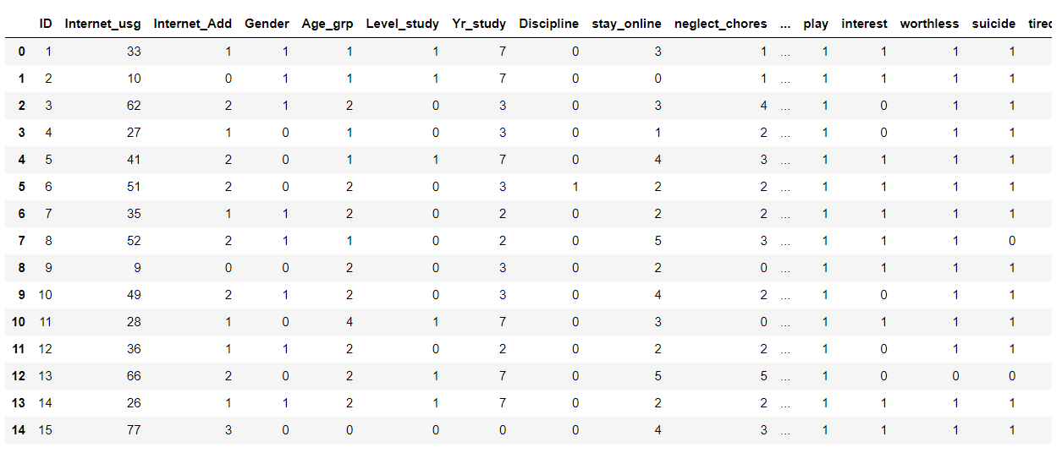

Slide 23
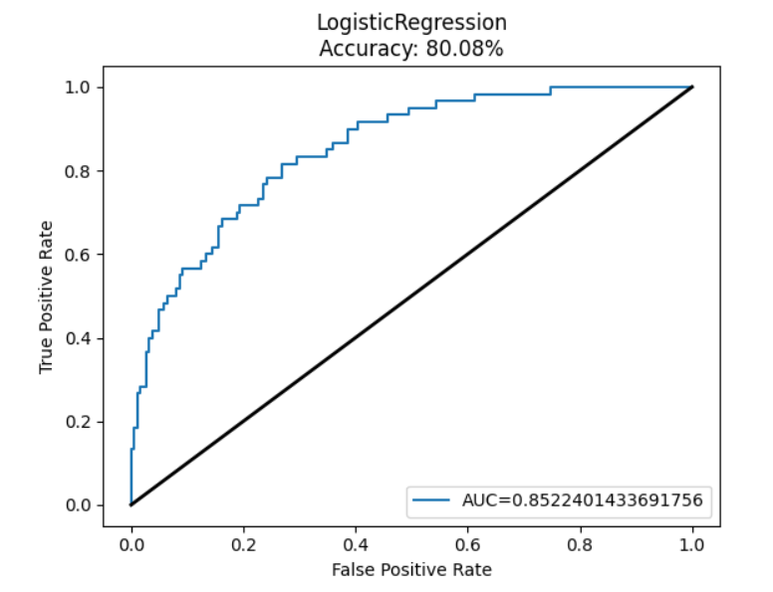
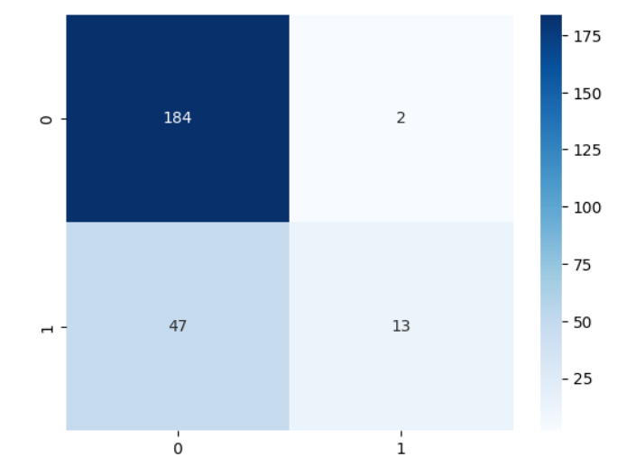
LOGISTIC OUTPUTS:

Slide 24
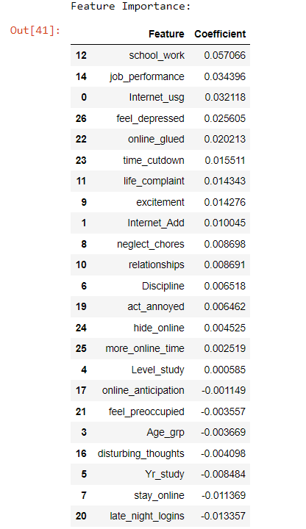
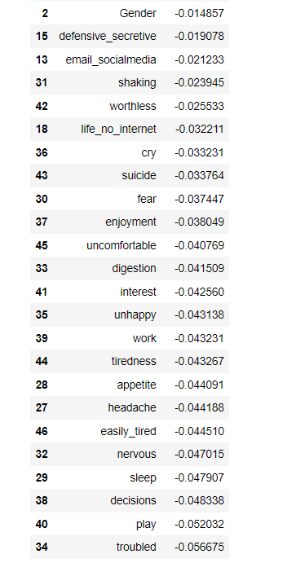
Feature Importance:

Slide 25
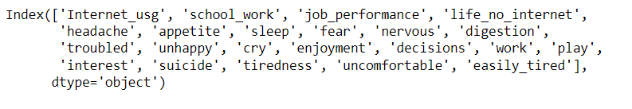
Selected features names

Slide 26
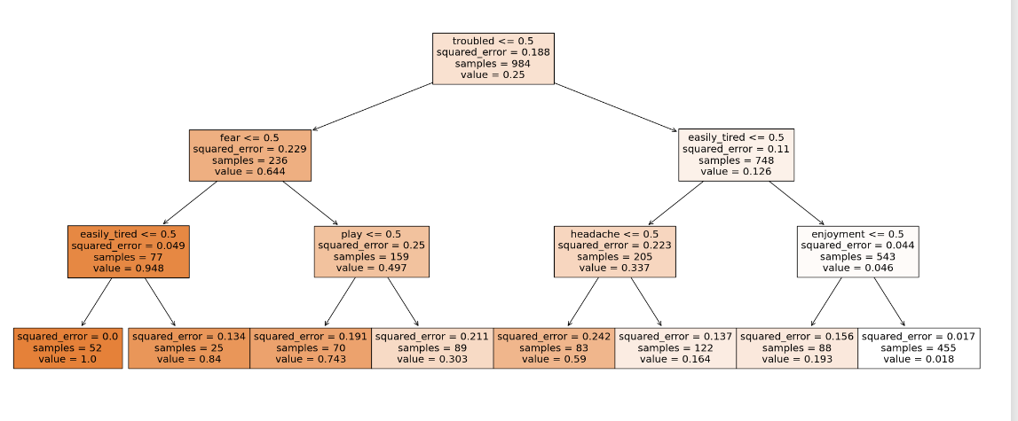
CHAID DECISION TREE OUTPUT:

Slide 27
CHAID DECISION TREE OUTPUT
There are several conditions or features being evaluated in this decision tree, including "easily tired", "fear", "troubled", "play", "headache", "enjoyment", and a few others that are not fully specified.
2.The "squared error" metric is used to evaluate the accuracy of the model. A squared error of 0 indicates a perfect prediction, while higher values indicate greater error.
3.The decision tree has several nodes with high values, indicating that the model is making accurate predictions for those categories. For example, the "easily tired <= 0.5" node has a value of 0.948 and a squared error of 0.049, indicating a high level of accuracy.
4.However, there are also several nodes with lower values and higher squared errors, indicating that the model is less accurate for those categories. For example, the "enjoyment < 0.5" node has a value of 0.046 and a squared error of 0.156, indicating less accuracy.

Slide 28
Novelty Details
Our research initially focused on building a decision tree model to predict outcomes based on various conditions or features. However, we recognized that there was room for improvement in terms of overall accuracy and predictive power.
To address this, we added several new machine learning algorithms and techniques, including Naive Bayes classification, Random Forest, Support Vector Machines (SVM), and K-Nearest Neighbors (KNN).
By comparing and analyzing these methods, we were able to significantly improve the accuracy and predictive power of our model, demonstrating the value of exploring multiple machine learning techniques.

Slide 29
Novalty Details
Algorithms Implemented:
Naïve Bayes Classification Algorithm (NB)
Support Vector Machine (SVM)
Random Forest Classifier (RFC)
K-Nearest Neighbours (KNN)

Slide 30
SVM Kernels
Support Vector Machine Kernels used:
Gaussian Radial Basis Function (RBF)
Polynomial
Sigmoid
Linear
The comparison of these kernels have been displayed below and the best Kernel is selected for other comparison.

Slide 31

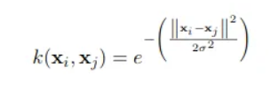

MATHEMATICAL FORMULAS:
Support Vector Machine:
Gaussian Radial basis function
Polynomial Kernel Function

Slide 32

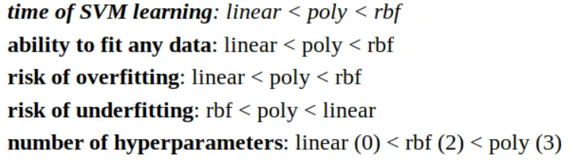
MATHEMATICAL FORMULAS:
Linear Kernel
Small comparison of all the above kernel:

Slide 33
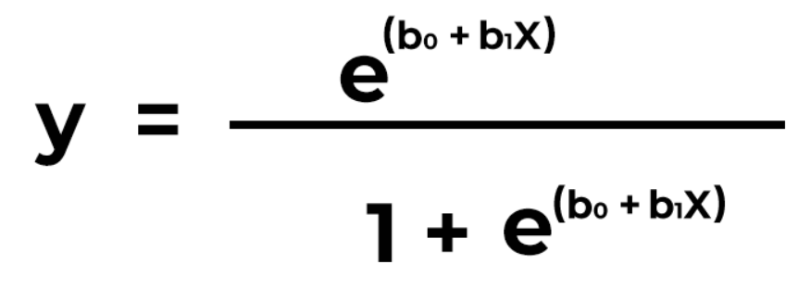
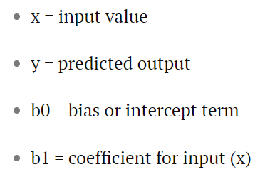
MATHEMATICAL FORMULAS:
Logistic Regression:

Slide 34
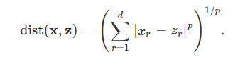
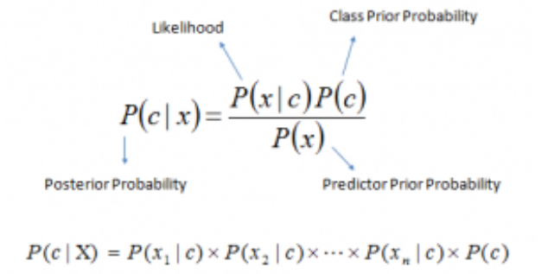
MATHEMATICAL FORMULAS:
k-nearest neighbours:
Minkowski distance
Naive Bayes Classifier

Slide 35
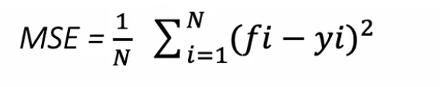
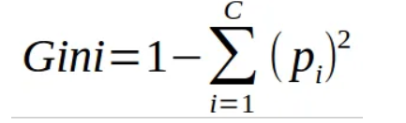
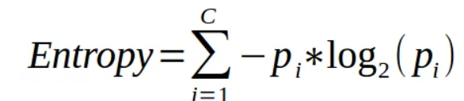
MATHEMATICAL FORMULAS:
Random Forest Algorithm:

Slide 36
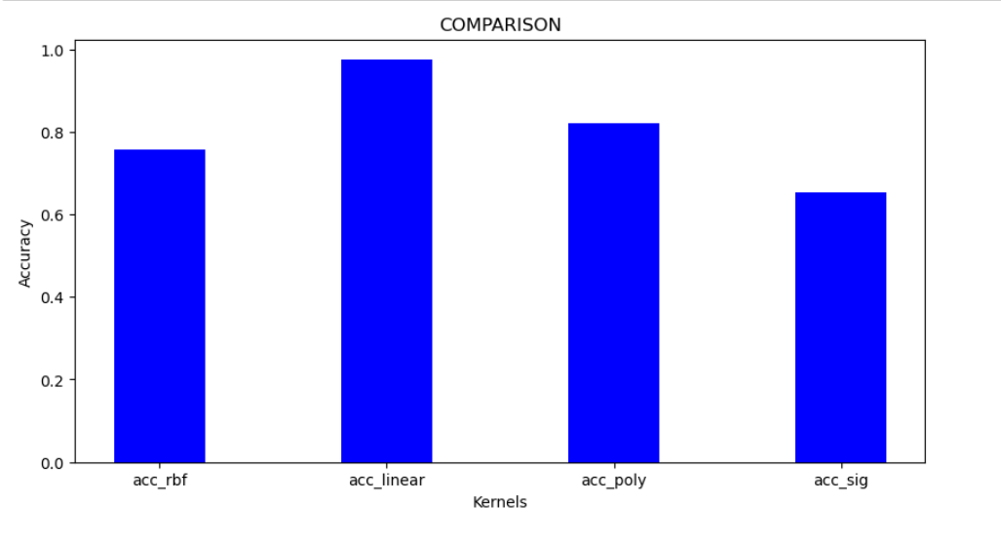
COMPARISON OF ALL SVM:

Slide 37
Final Comparison
After selecting the best kernel for our Support Vector Machine (SVM) model, we trained and tested it to evaluate its performance. We then compared it to other classification models, including CHAID Decision Tree, Random Forest, K-Nearest Neighbors (KNN), and Naive Bayes.
By comparing the accuracy scores of each model, we were able to determine which model performed the best for our specific use case. Ultimately, the Linear SVM Kernel model outperformed the other models, demonstrating its effectiveness for this particular classification task.

Slide 38
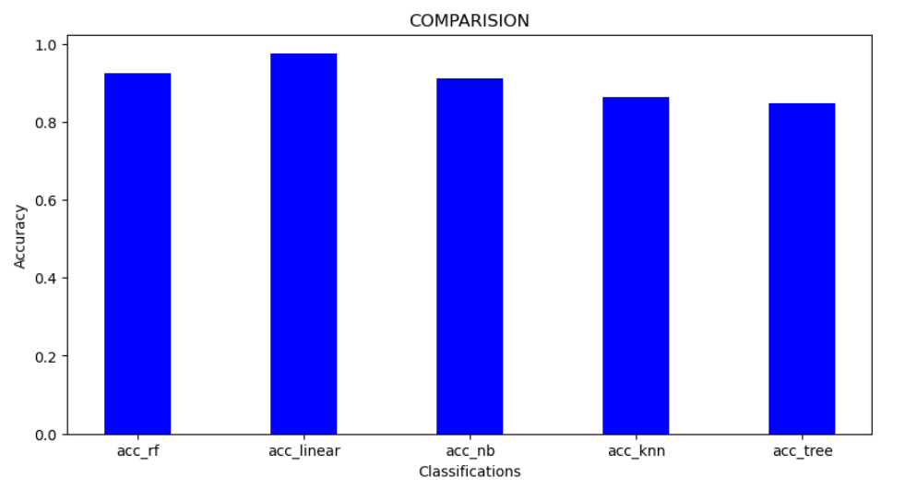
COMPARISON OF ALL CLASSIFICATION:

Slide 39
Conclusion
In conclusion, our study found that the Linear SVM Kernel model outperformed other classification models, including CHAID Decision Tree (accuracy score = 0.846 ), Random Forest (accuracy score = 0.923 ), K-Nearest Neighbors(accuracy score = 0.862 ), and Naive Bayes (accuracy score = 0.910 ), in terms of accuracy for our specific use case. This demonstrates the effectiveness of the Linear SVM Kernel model (accuracy score = 0.975) for this particular classification task, and highlights the importance of selecting the best kernel for SVM models. Future research could explore the application of this model to other datasets and use cases.
39

Slide 40
REFERENCES
· Astleitner, H., Bains, A., & Hormann, ¨ S. (2023). The effects of personality and social media experiences on mental health: Examining the mediating role of fear of missing out, ghosting and vague booking. Computers in Human Behavior, 138, Article 107436. https://doi.org/10.1016/j.chb.2022.107436
Chen, J. K., Chang, C. W., Wang, Z., Wang, L. C., & Wei, H. S. (2021). Cyber deviance among adolescents in Taiwan: Prevalence and correlates. Children and Youth Services Review, 126, 1–9. https://doi.org/10.1016/j.childyouth.2021.106042
Resnik, F., & Bellmore, A. (2019). Connecting online and offline social skills to adolescents’ peer victimization and psychological adjustment. Journal of Research on Adolescence, 48(2), 386–398.https://doi.org/10.1007/s10964-018-0953-z

